Slide 1
AUTOMATIC CONTROL 1 (ME 363)
BY
DR (MRS) EUNICE AKYEREKO ADJEI
FIRST SEMESTER, 2020/2021 ACADEMIC YEAR

Slide 2
OUTLINE OF PRESENTATION
COURSE CONTENT
INTENDED LEARNING OUTCOMES
INTENDED SKILLS ACQUIRED
STUDENT ACTIVITIES
GRADING
MINI-PROJECT DISSCUSION AND GROUPING

Slide 3
COURSE CONTENT OF ME 363
UNIT ONE : INTRODUCTION TO AUTOMATIC CONTROL
-Basic terminologies in Automatic Control, Classification of Automatic control, Components of Automatic Control, History and Application.
UNIT TWO: SYSTEM REPRESENTATION
-Block diagram and Signal Flow. Block Diagram, canonical block diagram, reduction of complex block diagram, multiple input system and application. Signal Flow: drawing of signal flow graphs, Maison's Gain Formula and application
UNIT THREE: SYSTEM ANALYSIS
-Laplace Transformation. Inverse Laplace Transformation, Transient response, Performance Indices, Stability Criterion (Routh Criterion).
UNIT 4: MODELING OF CONROL SYSTEMS
-Components of Control Systems: Electrical, Hydraulic and Pneumatic, Mechanical and Thermal Components.

Slide 4
COURSE CONTENT CONT’D…
UNIT FIVE: CONTROL SYSTEM SIMULATION
Analogue and Digital computers

Slide 5
INTENDED LEARNING OUTCOMES
On completion of this course, students are expected to do the following:
Describe and explain basic concepts and problems within control theory such as block diagrams, signal flow diagrams, mathematical modelling, state space representation, inputs and outputs, transfer functions, poles, zeros, input responses such as step, ramp, impulse, etc
Represent physical control systems using block diagram
Analyse linear system description with respect to dynamic properties such as stability and transient response
Outline examples of automatic control applications in Ghana.
Identify and solve industrial control problems

Slide 6
RECOMMENDED RESOURCES
The following are the recommended resources:
Ogata, K; “Modern Control Engineering’’
Raven, F. H.; “Automatic Control Engineering”
Driels, Morris; “Linear Control System Engineering”
D’Azzo, J. J. & Houpis, C. H.; “Linear Control System Analysis & Design “
Other relevant internet resources

Slide 7
GRADING
There will be four different grading methods as follows:
Final examinations (70%)
Industrial Application Mini-project (25%)
Mid semester (3%)
Assignments and quizzes (2%)

Slide 8
MINI-PROJECT DISSCUSIONS AND GROUPING
Write 25 pages report for this Mini-project using the format below:
Introduction
Problem
Models
Results/simulation
Conclusion
Mode of assessment (oral examination, poster presentation, peer evaluation assessment and report)

Slide 9
MINI-PROJECT DISSCUSIONS AND GROUPING
Project Tasks
Task 1
Identify Automatic Control components at the assigned application area.
Task 2
Identify the representative problems associated with the selected automatic control components at Task 1.
Task 3
Use block diagram to represent the system at Task 1 and Task 2; obtain the resulting transfer function to analyse the stability of the system and interpret the implication of stability on the physical system.
Task 4
Use mathematical model to represent the system at Task 1 and 2 .
Task 5
Write computer program to solve the problem identified at Task 2.

Slide 10
UNIT ONE
INTRODUCTION
HISTORY OF AUTOMATIC CONTROL DEVELOPMENT
CLASSIFICATION OF AUTOMATIC CONTROL
BASIC CONTROL SYSTEMS COMPONENTS AND TERMINOLOGIES
APPLICATION OF AUTOMATIC CONTROL
IMPORTANCE OF AUTOMATIC CONTROL
SUMMARY

Slide 11
UNIT ONE INTRODUCTION
WHAT IS AUTOMATIC CONTROL?
Automatic control is an arrangement of physical components connected or related in such a manner as to form and/or act as an entire unit.
Automatic control in a broad sense is concerned with the means by which systems may be made to behave in a desired way.
Automatic control is a research area, theoretical base for automation, employing knowledge from mathematics and engineering to make system behave in a desired way. A central concept is that system which is to be controlled, such as a rudder, propeller , process plant or an entire ballistic missile. The systems studied within Automatic Control 1 are mostly linear systems.
A control system is an interconnection of components forming a configuration that will provide a desired system response.

Slide 12
HISTORY OF CONTROL SYSTEM DEVELOPMENT
The roots (before 1940)
Some of the early inventions include the use of feedback in windmills, steam engines, engines, ships, airplanes, process control and telecommunication.
Detail:
1620 Temperature regulator of a furnace (Drebbel)
1698 Steam-powered machine (Thomas Savery)
1788 Steam engine governor ( James Watt)
1868 Governor control analysis (Electromagnetic field equations)(James Clark Maxwell)
1873 Book on servomotors (Jean Joseph)
1907-1914 Active stabilizer, the gyrocompass an gyroscope autopilot (Elmer Sperry)
1927 Telephone amplifier analysis (Bode)
1932 Stability analysis (Nyquist)
The field emerges (1940-1945)
During the Second World War, the field widened like wild fire, examples include education, industries and organizations.
Detail:
1940 Autopilots, gun directors, radar, etc.

Slide 13
The second wave (1950--)
There were some demanding applications of controls in the space, and process industry, for example etc. New components like the digital computer were then invented.
Detail:
1952 Machine tool numerical control
1970 State variable models, optimal control
1994 Extensive use of feedback control in automobiles.

Slide 14
CLASSIFICATION OF AUTOMATIC CONTROL
Control system can be classified broadly by types or configurations:
Open-loop Type
Closed-loop Type
Type of Input
SISO, MIMO, SIMO, MISO
By Applications
By Creation

Slide 15
Open-loop control systems
An open-loop control system is one in which the control input to the system is not affected in any way by the output of the system.
They are generally relatively simple and therefore often inexpensive.
The response of an open-loop system is dependent on the characteristics of the system itself in terms of the relationship between the system input and output signals.
If the system characteristics change at some time then both the response accuracy and repeatability can be severely impaired.
Examples include automatic electric toasters and washing machines.

Slide 16
An open-loop system may be:
Continuous type (example steam turbine without governor) or
Sequential type (example pneumatic/hydraulic actuators).
In the presence of disturbances, an open-loop control system will not perform the desired task.
Open-loop control can be used in practice only if the relationship between the input and output is known and if there are neither internal nor external disturbances.

Slide 17
Open-loop control systems
Assignment
Describe Open-loop control system and outline some examples

Slide 18
Closed-loop control systems
In closed-loop systems, the control input is affected by the system output.
Often, the signal feedback from the system output is compared with a reference input signal; the result of this comparison (the difference) is then used to obtain the control or actuate the system input.
In a closed-loop control system, the actual error signal, which is the difference between input signal and the feedback signal, is fed to the controller so as to reduce the error and bring the output of the system to a desired value.
The term closed-loop control always implies the use of feedback control action in order to reduce system error.

Slide 19
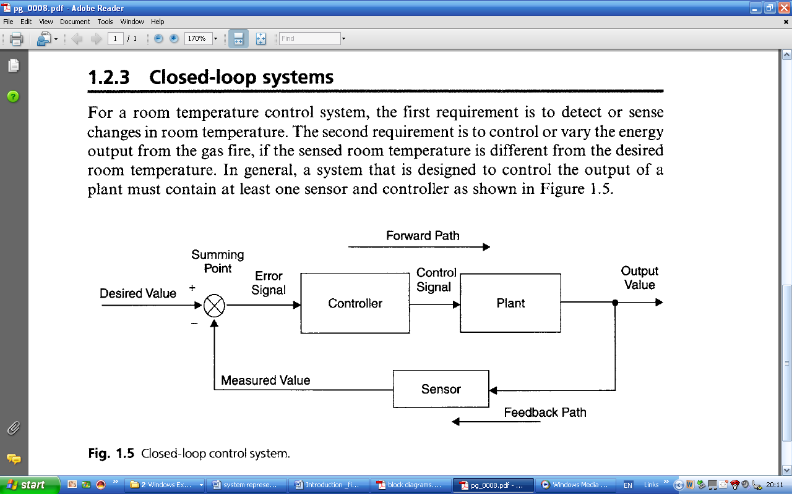
Figure 1 shows the generalized schematic block diagram for a closed-loop or feedback control system.
Figure 1: closed loop system

Slide 20
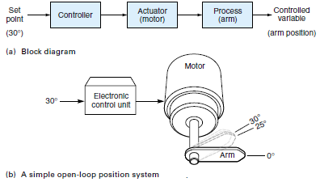
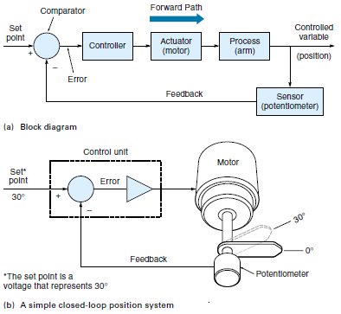
open-loop vrs closed-loop system
An open-loop system
A closed-loop system

Slide 21
Difference between feedback and feed forward
The following is the list of advantages and drawbacks of both control techniques.
FEEDBACK:
Advantage: a general-purpose error correction mechanism reacts to the error itself, not to the factors causing it.
Drawback: the error correction mechanism is activated by occurring errors, which results in increased response time.
Note that the closed-loop of mechanical/electrical/information transformations is formed only in a feedback control system.

Slide 22
FEEDFORWARD:
Advantage: it reacts to particular disturbances before they cause system errors, which results in a very short response time,
Drawback: it "protects" the controlled plant only from specific disturbances, acting as a special purpose error correction mechanism.
Note that the sequence of mechanical/electrical/information transformations taking place on a feed forward control system does not form a closed loop. Feedforward control is also known as open loop control.
It could be concluded, therefore, that feedback normally presents the most practical technique for the development of a control system. However, in a situation when the controlled plant is affected by a small number of dominant disturbances, which can be properly monitored, the feedback could be supplemented by a feed forward mechanism, responsible for dominant disturbances.

Slide 23
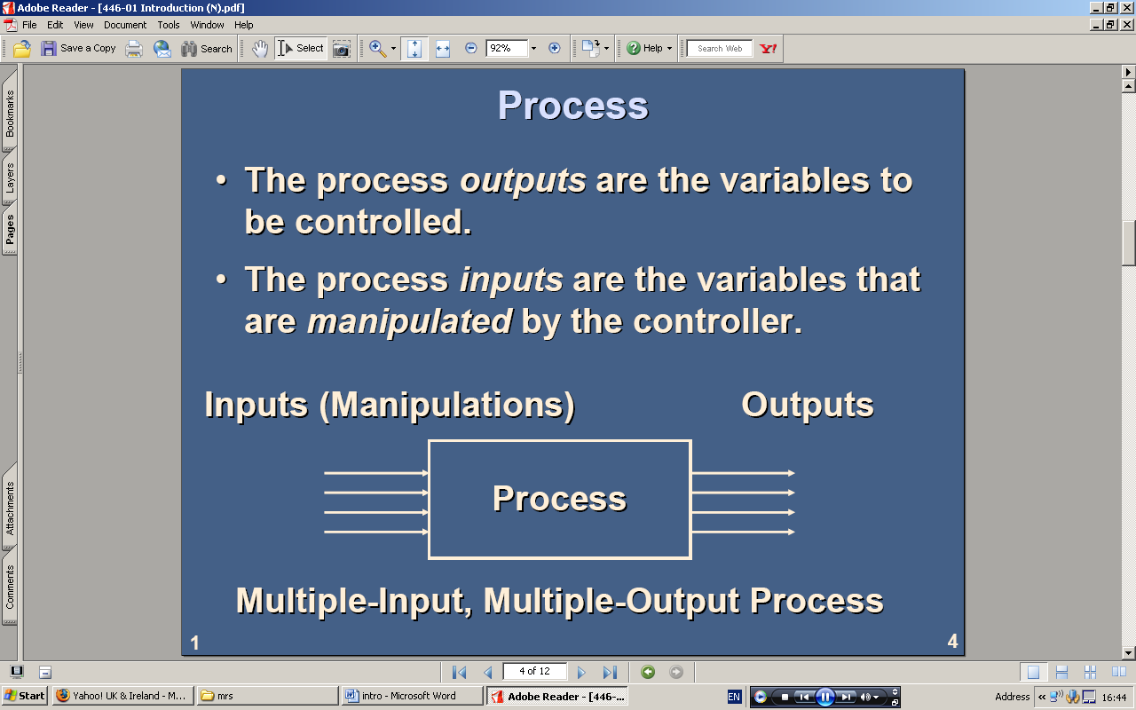
CLASSIFICATION CONT’D…
Input/output Classification
By input/output – a) single input single output
b) Single Input multiple Output
c) Multiple Input Single Output
d) Multiple Input Multiple output.
Examples of MIMO and SISO systems are shown below

Slide 24
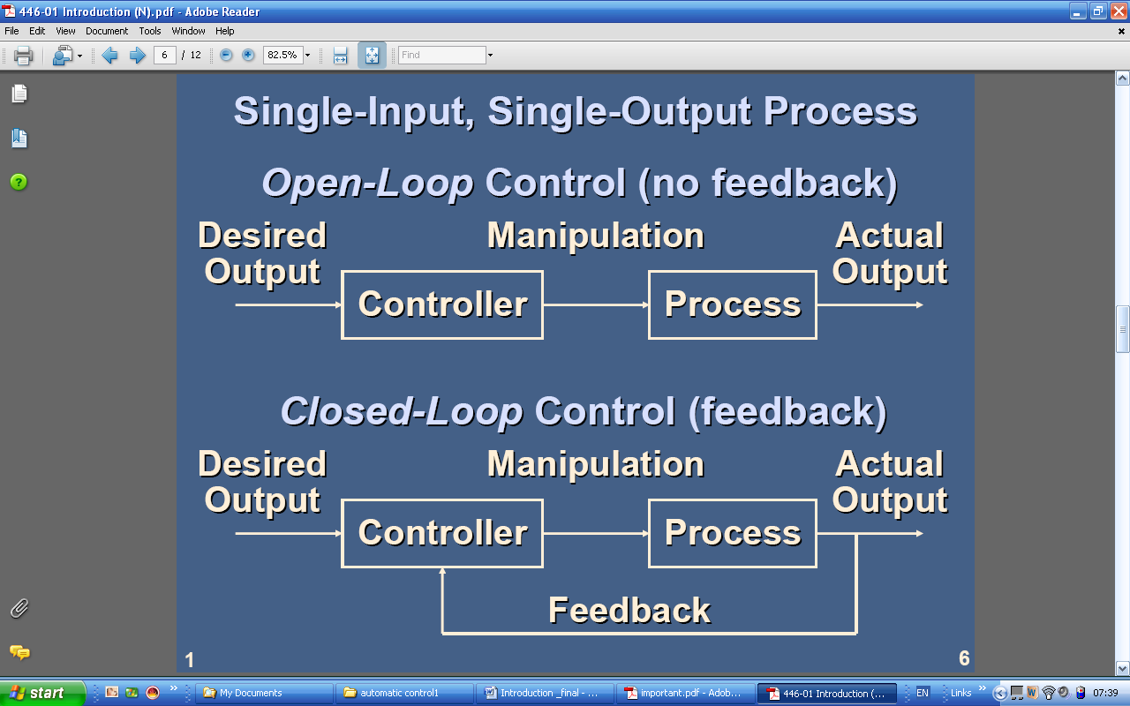
Assignment
Briefly describe input/output classification of control systems and give examples.

Slide 25
CLASSIFICATION OF CONTROL SYSTEMS Cont’d…
Application Classification
By Applications – Control systems can be divided into three categories based on role they play. These are:
(a) Regulator (Maintain variables for example, Speed, voltage, temperature at specified value.
(b) Servo Mechanism (behaves like a tracking device)-control motion parameters like displacement, velocity and accelerations.
(c ) Process Control industrial processes

Slide 26
CLASSIFICATION OF CONTROL SYSTEMS cont’d…
Creation Classification
By Creation classification, we have Man made Control Systems, Natural control systems example bilogical as well as Hybrid Control systems whose components are both man-made and natural.
Others : Linear system, nonlinear systems time- variant system, time- invariant system, analogue and digital control systems.

Slide 27
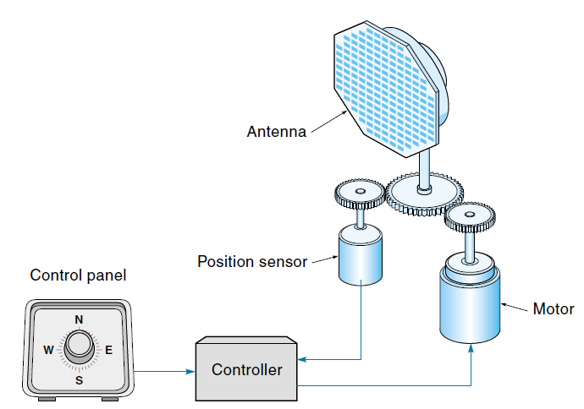
Motion Controls Servomechanism
CLASSIFICATION CONT’D…
Servomechanism is the traditional term applied to describe a closed-loop electromechanical control system that directs the precise movement of a physical object such as a radar antenna or robot arm.

Slide 28
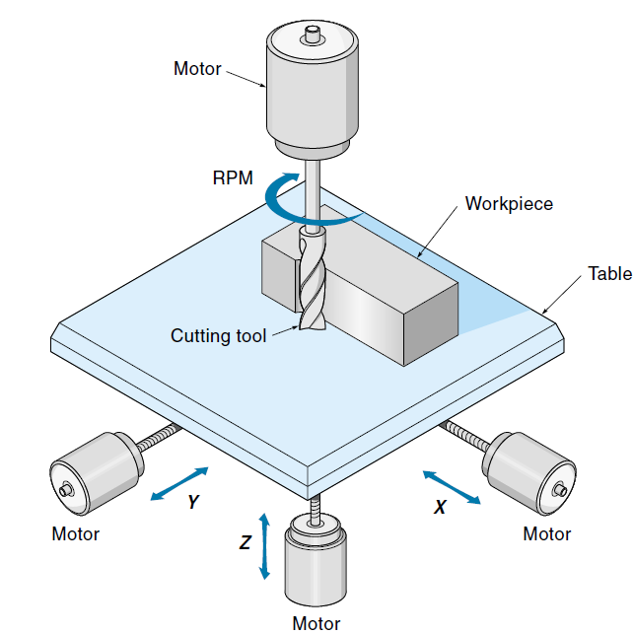
Motion Controls Numerical control
Numerical control (NC) is the type of digital control used on machine tools such as lathes and milling machines. These machines can automatically cut and shape the work piece without a human operator.

Slide 29
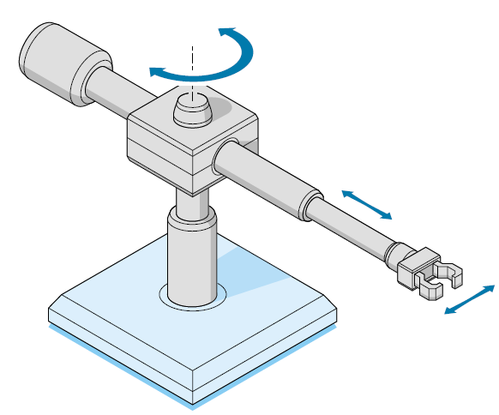
Motion Controls Robotics Pick-and-place robots
Industrial robots are classic examples of position control systems. In most cases, the robot has a single arm with shoulder, elbow, and wrist joints, as well as some kind of hand known as an end effector.

Slide 30
BASIC TERMINOLOGIES
Control
Control means to maintain a particular operation, status, or performance of a physical process. Control is automatic if it is accomplished without manual (human) intervention.
Controlled variable and manipulated variable
The controlled variable is the quantity or condition that is measured and controlled. The manipulated variable is the quantity or condition that is varied by the controller so as to affect the value of the controlled variable. Normally the controlled variable is the output of the system. Controlled variable represents quantitatively the actual operation, status, or performance of the controlled process.

Slide 31
Disturbance
A disturbance is a signal that tends to adversely affect the value of the output of a system. If a disturbance is generated within the system, it is called internal, whilst external disturbance is generated outside the system. Disturbance signals represent all external (and sometimes internal) factors that result in the undesirable deviations of controlled variables from their required values.
Reference
Reference is the signal that represents the desired operation, status, or performance of a controlled process. The controlled variables (referred to above) are represented by particular low power electric signals following some scale. The reference signals have the same order of magnitude and power as the signals representing controlled variables, but are defined by the human operators of the process.

Slide 32
Controlled plant or controlled process
Controlled plant or controlled process - is the physical process, i.e., the combination of physical transformations, which must be maintained according to a precisely defined operational regime.
Processes
The process is the component (or group of components) to be controlled.
Systems
A system is a combination of components that act together and perform a certain objective. A system is not limited to physical ones. The concept of the system can be applied to abstract dynamic phenomena such as those encountered in economics. System can be interpreted to imply physical, biological, economic, etc.

Slide 33
Error signal
Error signal is the difference between the actual and desired values of the controlled variable, or between the reference and transducer signals.
Feedback control
Feedback control refers to an operation that, in the presence of disturbances tends to reduce the difference between the output of the system and some reference input. Here only unpredictable disturbances are specified, since predictable or known disturbances can always be compensated for within the system.
Feedback control systems
A system that maintains a prescribed relationship between the output and the reference input by comparing them and using the difference as a means of control is called a feedback control system. An example is room temperature, comparing it with the reference temperature (desired temperature), the thermostat turns the heating or cooling equipment on or off in such a way as to ensure the room temperature remains at a comfortable level regardless of outside conditions.

Slide 34
Sensor(s)
It is used to measure some physical state such as temperature or liquid level. It is the part of a measuring instrument which responds directly to changes in the environment, example automatic doors and some water closets toilet.
Transducer
This is a device that transforms one form of energy into another. Transducers use basic physical laws to measure physical parameters using a sensing element that is the core of the transducer. Transducer is a technical device that transforms a controlled variable into an electrical signal thus providing the quantitative characterization of the actual operation, status or performance of the controlled process.

Slide 35
Actuator
A device that creates mechanical motion by converting various forms of energy to rotating or linear mechanical energy. Actuators may be used for flow-control valves, pumps, positioning drives, motors, switches, relays and meters. Actuation signal symbolizes the control efforts applied to the controlled plant in order to provide the desired effects on its status or performance.
Plant
A plant may be a piece of equipment perhaps just a set of machine parts functioning together, the purpose of which is to perform a particular operation e.g. (Mechanical device, a heating furnace, a chemical reactor or spacecraft).
Servomechanism
This is an electric, hydraulic, or pneumatic device that performs power amplification of the control signal, generating a control effort.

Slide 36
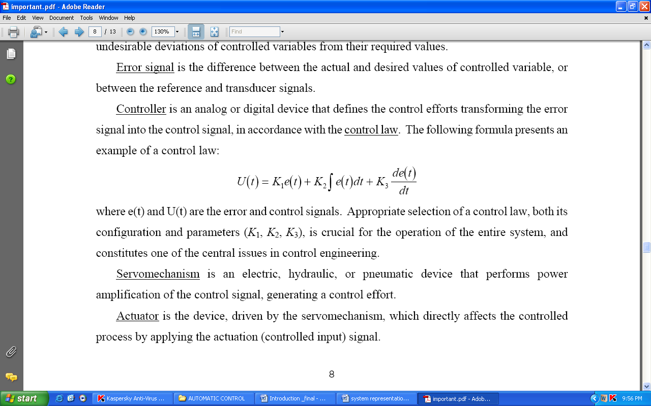
Controller
It is the component (or group of components) that controls the process. The controller outputs are the variables that manipulate the process. The objective of the controller is to make the actual values of the process output variables equal to the desired values. Controller is an analog or digital device that defines the control efforts transforming the error signal into the control signal, in accordance with the control law. The following formula presents an example of a control law:

Slide 37
CURRENT APPLICATIONS OF AUTOMATIC CONTROL SYSTEMS
Generation of energy
In an electric power system, automatic generation control (AGC) is a system for adjusting the power output of multiple generators at different power plants, in response to changes in the load. Since a power grid requires that generation and load closely balance moment by moment, frequent adjustments to the output of generators are necessary. The balance can be judged by measuring the system frequency; if it is increasing, more power is being generated than used, which causes all the machines in the system to accelerate. If the system frequency is decreasing, more load is on the system than the instantaneous generation can provide, which causes all generators to slow down. Types of the AGC are: Turbine Governor Control (TGC), Load –Frequency Control (LFC), and Economic Dispatch.

Slide 38
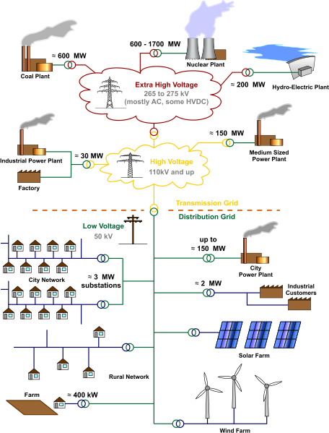
Figure 2:
An electrical grid may have many types of generators and loads; generators must be controlled to maintain stable operation of the system.

Slide 39
Transmission of energy
Economic dispatch
The goal of economic dispatch is to minimize total operating costs in an area by determining how the real power output of each generating unit will meet a given load. Generating units have different costs to produce a unit of electrical energy, and incur different costs for the losses in transmitting energy to the load. An economic dispatch algorithm will run every few minutes to select the combination of generating unit power setpoints that minimizes overall cost, subject to the constraints of transmission limitation or security of the system against failures. Further constraints may be imposed by the water supply of hydroelectric generation, or by the availability of sun and wind power.

Slide 40
Communication
In any system, there are internal communication mechanisms that allow components
to interact and exhibit a collective behavior, the system behavior. For example, in
an electronic circuit, transistors, capacitors, resistances are connected so current can
flow among them and the circuit can exhibit the behavior it was designed for. Such
internal communication is an integral part of any system.
At a higher level, subsystems that each can be quite complex interact via external communication links that may be wired or wireless. This is the case for example in antilock brake systems,
vehicle stability systems, and engine and exhaust control systems in a car or among
unmanned aerial vehicles that communicate among themselves to coordinate their
flight paths. Such external to subsystems communication is of prime interest in automated systems.

Slide 41
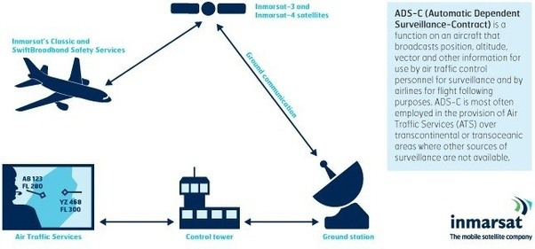
Figure 3: An automatic communication system for air traffic control.

Slide 42
Processing industries
A process automation or automation system (PAS) is used to automatically control a process such as chemical, oil refineries, paper and pulp factories. The PAS often uses a network to interconnect sensors, controllers, operator terminals and actuators. A PAS is often based on open standards in contrast to a DCS (distributed control system), which is traditionally proprietary. However in recent times the PAS is considered to be more associated with SCADA (supervisory control and data acquisition) systems.
PAS is the lowest level of automation, while MES (manufacturing execution system) is considered to be directly positioned above a PAS. Process automation involves using computer technology and software engineering to help power plants and factories in industries as diverse as paper, mining and cement operate more efficiently and safely.
In the process industries, control is used to regulate liquid level, pressure and temperature of chemical refinery vessels.
In a steel rolling mill, the position of the rolls is controlled according to the measure of thickness of the steel coming off the finishing line.

Slide 43
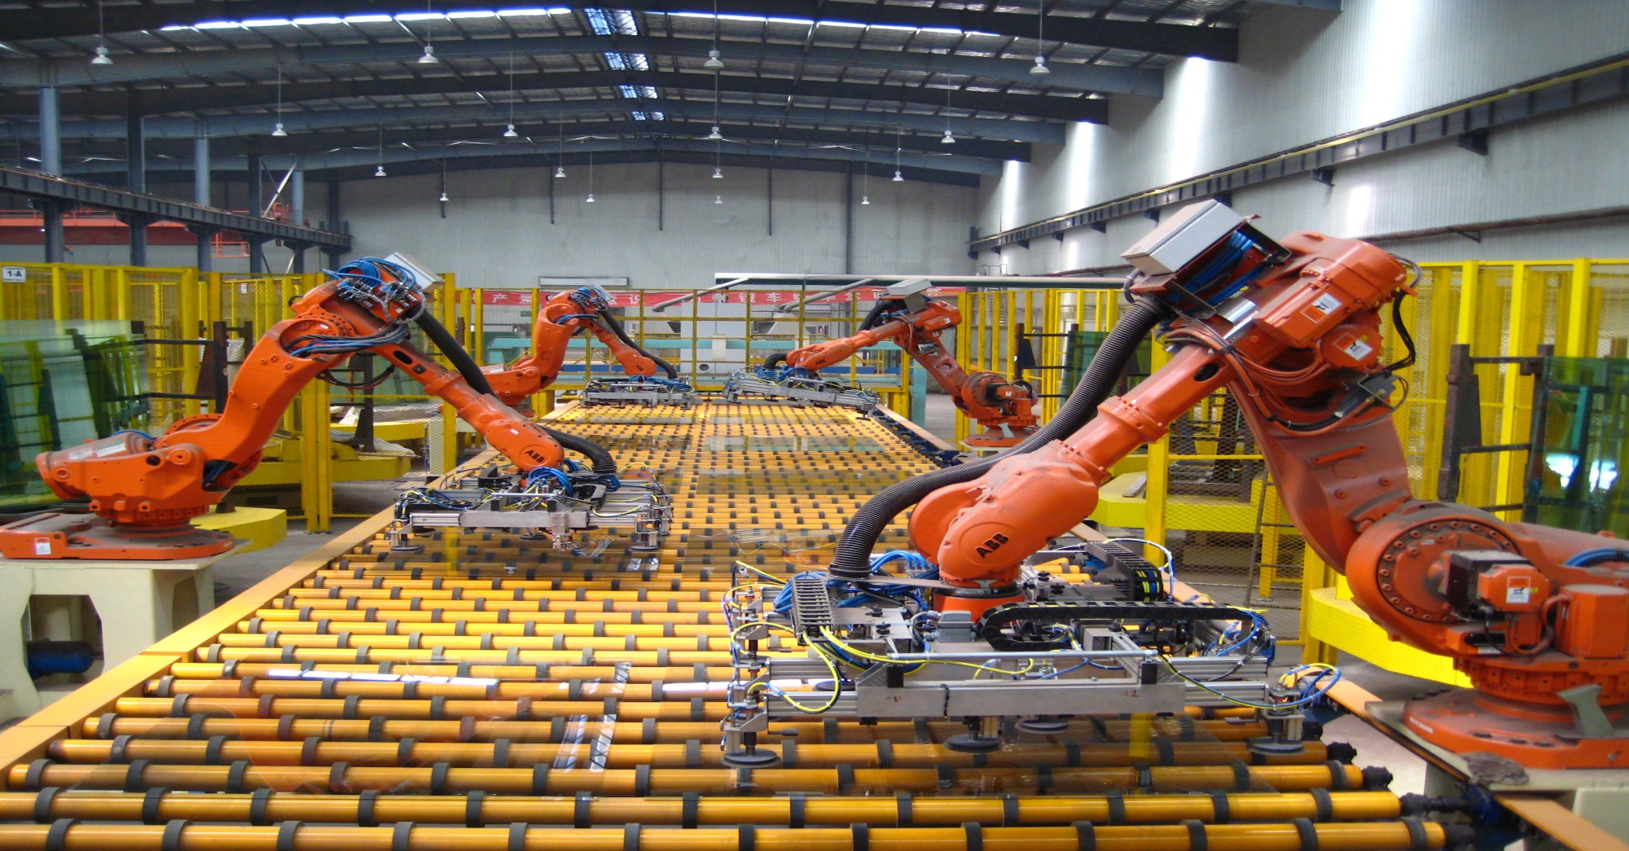
Manufacturing
Figure 4: Automated (Robotic) manufacturing.

Slide 44
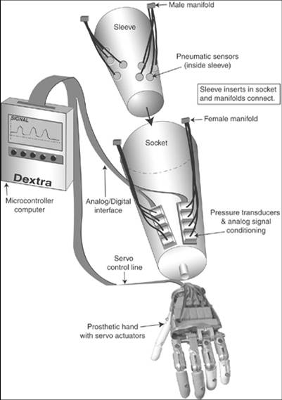
Mechatronics
Mechatronics is related to the systems control area, and includes knowledge of robotics and electronics. It involves the creation of embedded systems. Mechatronics evolved out of the Japanese automotive industry in the 1970s but has come to include many consumer goods that incorporate embedded systems. Embedded systems are found in many of the products used widely, and a good example would be a “smart” seat in a car. A smart seat would have its own sensors and ability to remember ones setting and automatically adjust itself to ones specifications.
Figure 5: A mechatronic system for automated (robotic) application.

Slide 45
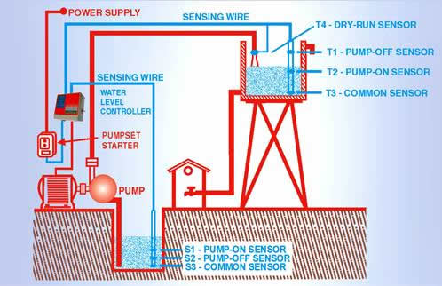
Water level in a reservoir of a chemical plant can increase due to rains, and decrease due to consumption and evaporation. It is controlled by pumping water from main source pipe system or pole hole, using a reversible pump. Suggest a control procedure for maintaining the required water level.
Figure 6: Automatic Water Level Control

Slide 46
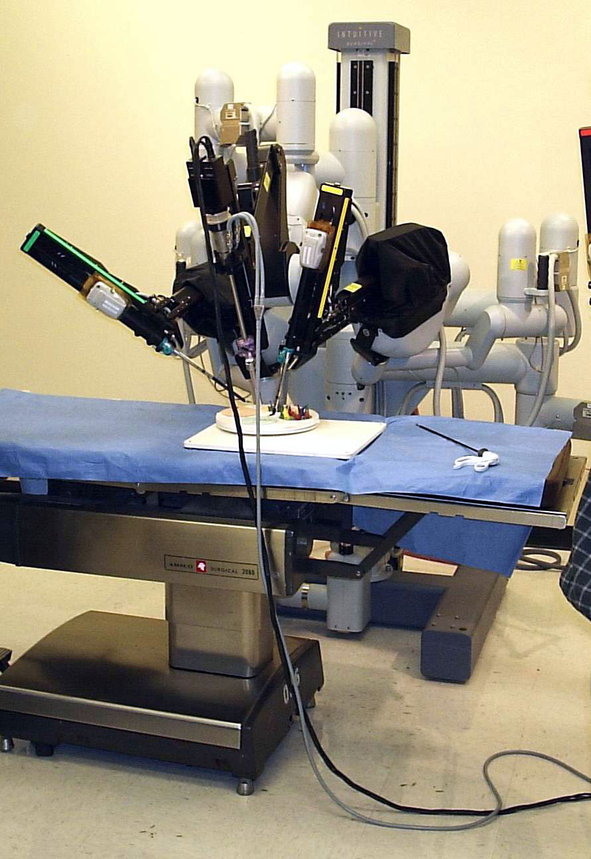
Biology and Medicine
Robotic surgery, computer-assisted surgery, and robotically-assisted surgery are terms for technological developments that use robotic systems to aid in surgical procedures. Robotically-assisted surgery was developed to overcome the limitations of pre-existing minimally-invasive surgical procedures and to enhance the capabilities of surgeons performing open surgery.
Figure 7: A robotically assisted surgical system used for prostatectomies, cardiac valve repair and gynaecologic surgical procedures.

Slide 47
APPLICATIONS CONT’D…
Other current applications of automatic control system can be found in:
Instrumentation systems: Sensors to measure process conditions and valves to influence process operations are essential for all aspects of engineering practice. Engineers want to design and operate processes that remain in safe conditions, produce the desired amounts of high quality products and are profitable. Therefore, engineers must provide measuring devices for key variables and valves (or other devices, such as variable speed electric motors).
Transportation (cars, Trains, ships, aircrafts, spacecraft): eg. Cruise control, adaptive cruise control.
Engine regulation, active suspension systems and anti-lock braking systems in automobile.
Steering of missiles, planes, aircraft and ships at sea
For example, modern ships use a combination of electrical, mechanical and hydraulic components to develop rudder commands in response to desired heading. The rudder commands, in turn produce a rudder angle, which steers the ship.

Slide 48
APPLICATIONS CONT’D…
Aeronautics : guidance and navigation.
Aviation/ Avionics: autonomous flight of unmanned aerial vehicles (drones).
Home: eg: air conditioner, entertainment systems.
CD Players, the position of the laser spot in relation to the microscopic pits in a Compact Disc is controlled.
Video Recorders, the tracking of the record and play-back heads are controlled by controlling the velocity of the tape.
Central heating systems use thermostats to measure and control the temperature in the room.
Marine: Communication between Bridge and Engine Room
Precise temperature control of engine cooling system makes it possible to operate the engines without stopping

Slide 49
EMERGING APPLICATIONS OF AUTOMATIC CONTROL SYSTEMS
• Propulsion: Full authority digital engine control (FADEC )
• Air Traffic Control Management
Automated mining
Automated video surveillance
Automated highway systems
Automated waste management
Agent-assisted automation

Slide 50
Importance of control systems
They are used in domestic equipment such as washing machines and CD players, in cars and aircraft, in marine systems and the robots that assemble cars, explore the depths of the sea or the surface of planets.
Used in the design and operation of medical equipment and in the design of aids for people with mobility problems.
In addition, it is of extreme importance in space vehicle systems, missile, etc.
Automatic control has become an important and integral part of modern manufacturing and industrial processes.

Slide 51
IMPORTANCE CONT’D…
It is also essential in industrial operations such as controlling pressure, temperature, humidity, viscosity, and flow in the process industries.
Automatic control provides the means for attaining optimal performance of dynamic systems, improving productivity, relieving one the drudgery of many routine and repetitive manual operations.
Dangerous Applications.
It is used to compensate for Human Deficiencies.
Used in Power Amplification.
Compensation of Disturbances.

Slide 52
Summary
In order to design and implement a control system, the following essential generic elements are required:
Knowledge of the desired value: It is necessary to know what it is you are trying to control, to what accuracy, and over what range of values. This must be expressed in the form of a performance specification. In the physical system this information must be converted into a form suitable for the controller to understand (analogue or digital signal).
Knowledge of the output or actual value: This must be measured by a feedback sensor, again in a form suitable for the controller to understand. In addition, the sensor must have the necessary resolution and dynamic response so that the measured value has the accuracy required from the performance specification.

Slide 53
Knowledge of the controlling device: The controller must be able to accept measurements of desired and actual values and compute a control signal in a suitable form to drive an actuating element. Controllers can be a range of devices, including mechanical levers, pneumatic elements, analogue or digital circuits or microcomputers.
Knowledge of the actuating device: This unit amplifies the control signal and provides the 'effort' to move the output of the plant towards its desired value. In the case of the room temperature control system the actuator is the gas solenoid valve and burner, the 'effort' being heat input (W). For the ship autopilot system, the actuator is the steering gear and rudder, the 'effort' being turning moment (Nm).
Knowledge of the plant: Most control strategies require some knowledge of the static and dynamic characteristics of the plant. These can be obtained from measurements or from the application of fundamental physical laws, or a combination of both.

Slide 54
QUESTIONS

